Slide 1
3D Displays with No Ghosting
for Viewers Without Glasses
Steven Scher
Jing Liu
Rajan Vaish
Prabath Gunawardane
James Davis
University of California Santa Cruz
3D + 2D TV
SIGGRAPH 2013

Slide 2

3DTV
Notes:
A 3DTV lets you see 3D through stereo glasses

Slide 3
3DTV
3DTV
Notes:
Current 3DTV’s show a double-image to anyone not wearing stereo glasses

Slide 4
3DTV
3DTV
Notes:
The 3D effect is achieved by alternately showing two images on the same screen, while stereo glasses make sure that the left eye sees one picture, while the right eye sees the other. The two images show horizontally-shifted copies of each object.

Slide 5
3DTV
3DTV
Notes:
Viewers without glasses see both images with both eyes. They see two of everything, slightly offset horizontally.

Slide 6
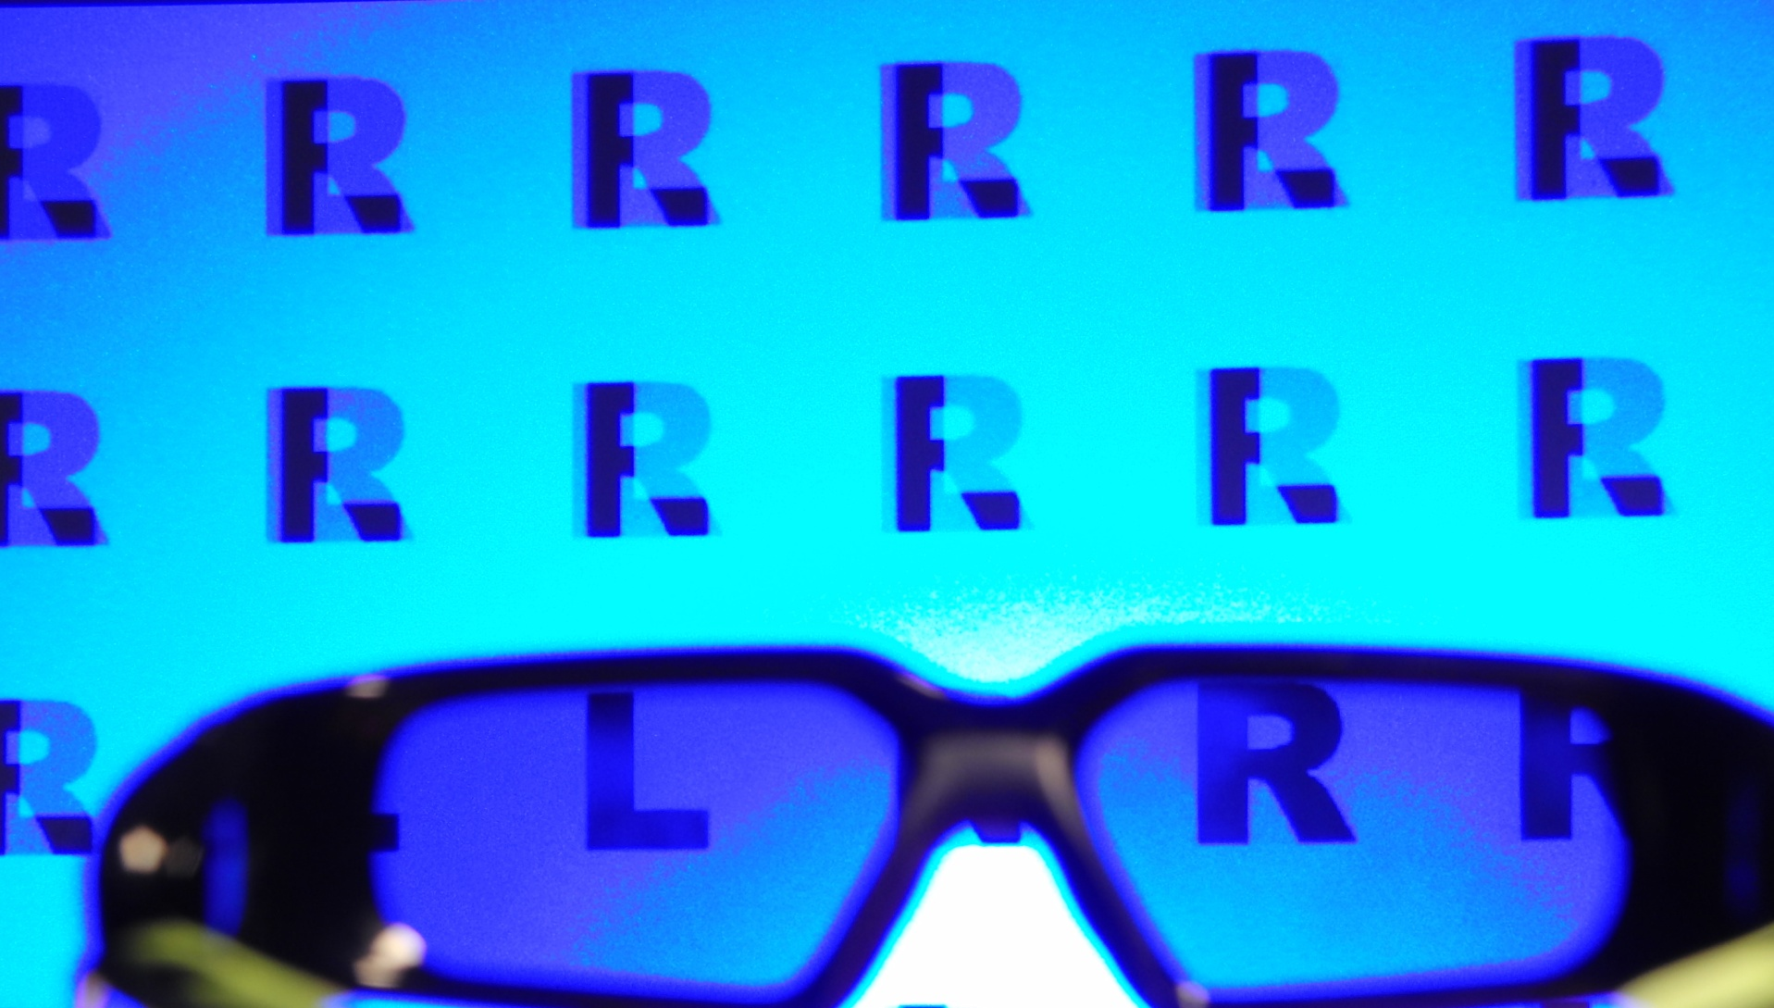
Standard 3D TV
Notes:
This is a standard 3DTV.
At the bottom of the screen, through the stereo glasses, separate Left and Right images are visible.
Above the glasses, the two images are superimposed.

Slide 7
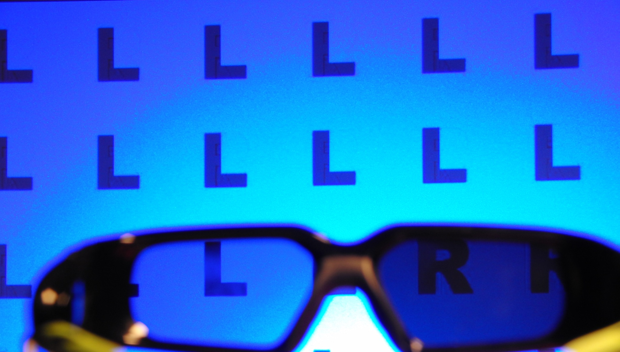
3D+2DTV Prototype
Notes:
This is our 3D+2DTV prototype.
Through the stereo glasses, separate Left and Right images are visible, as before.
Above the glasses, only the Left image is visible.

Slide 8
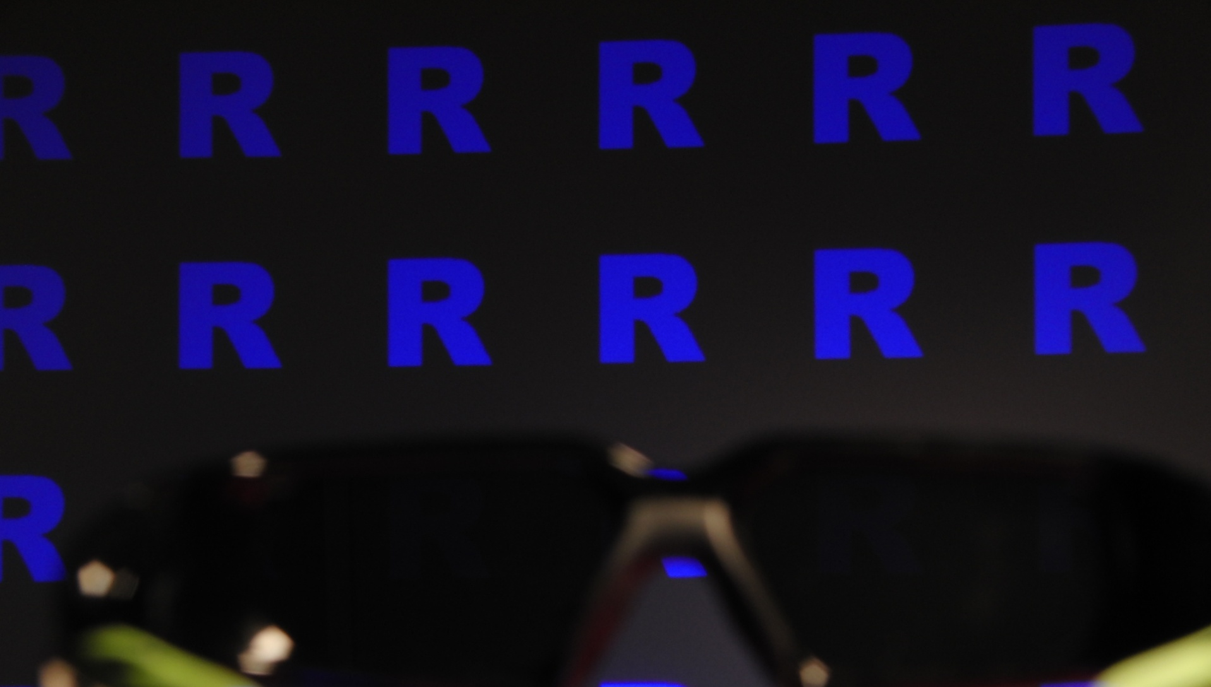
Third, Inverted Image
Notes:
A third image is shown only to thoseWithout stereo glasses. It is the inverse of the Right image: bright where the original is dark, and vice-versa. These two sum to gray, leaving only the Left image.

Slide 9
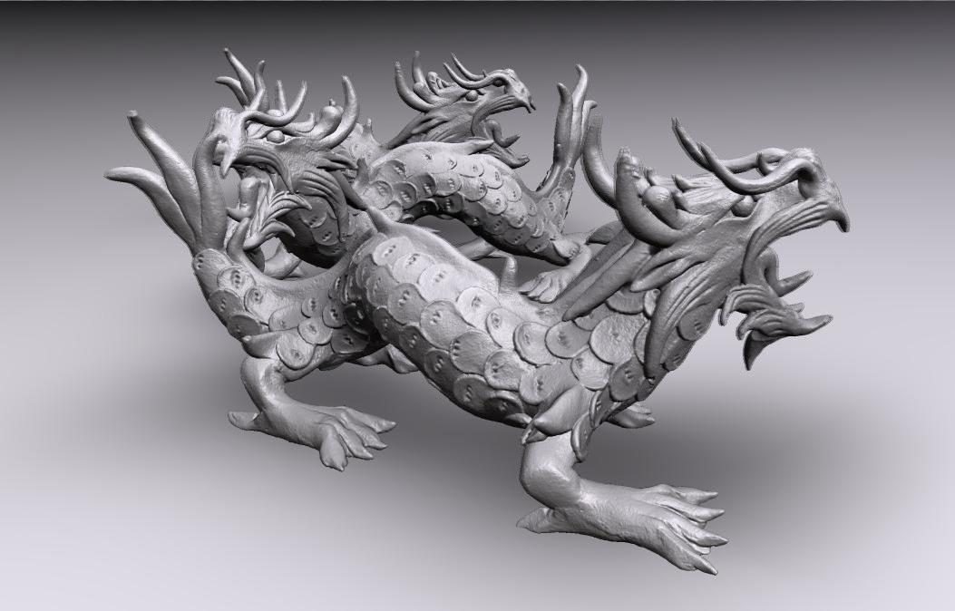
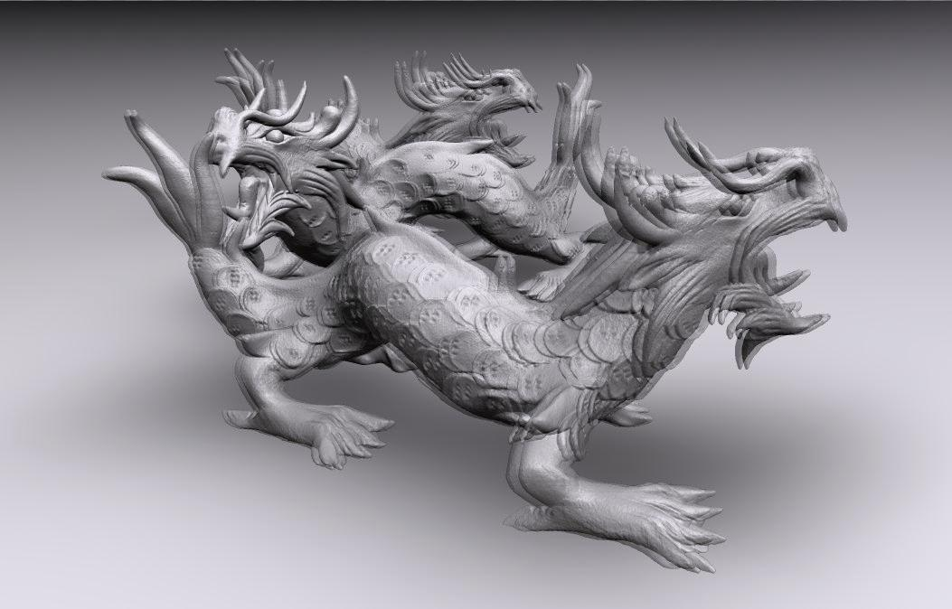
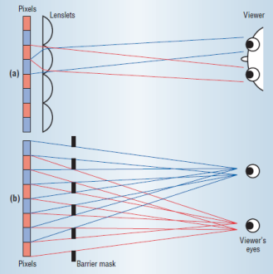
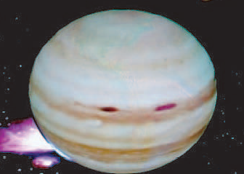
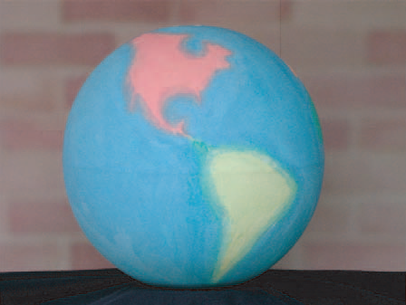
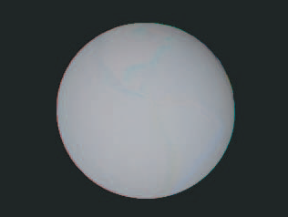
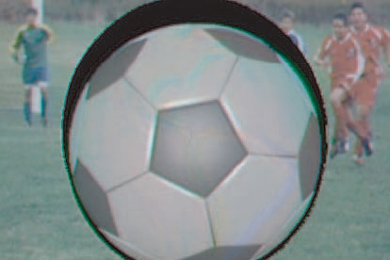
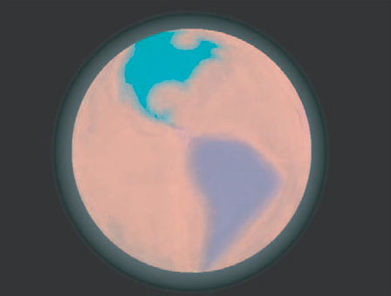
Related Work
Minimizing disparity
Autostereoscopic Displays
Didyk 2011
Dodgson 2005
Projecting onto a Non-Uniform Surface
Grossberg 2004
Notes:
*Didyk et al’s Backwards-Compatible Stereo had the same objective. They reduced the disparity of the 3D view to reduce the double-image in the 3D view.
* Autostereoscopic displays obviate the need for a 3D+2DTV, but expense and artifacts prevent widespread use.
* Canceling one image with another has been used for other applications as well.

Slide 10
Theory
Experiments
Prototype

Slide 11
Standard 3DTV
Time
L + R
2D
Same for Both Eyes
R R R R
R R R R
R R R R
L L L L
L L L L
L L L L
3D
L L L
R R R
As Seen Without Stereo Glasses
Notes:
A 2D TV shows the same image to both eyes.
A 3D TV alternates between two images, shown separately to the left and right eyes.

Slide 12
3D+2DTV
Time
L + R+(1-R)
2D
Same for Both Eyes
L L L L
L L L L
L L L L
3D
L L L
R R R
3D+2D
L L L
R R R
R R R
As Seen Without Stereo Glasses
Notes:
Our 3D+2DTV alternates between three images: Left, Right, and (Inverse of Right). To the 2D viewer, the R + (1-R) cancel, summing to grey, so that only L is visible.
There’s a problem here: the darkest pixel isn’t very dark, because R+(1-R) is always 1. We would like to leave L as it is, but reduce R and (1-R)

Slide 13
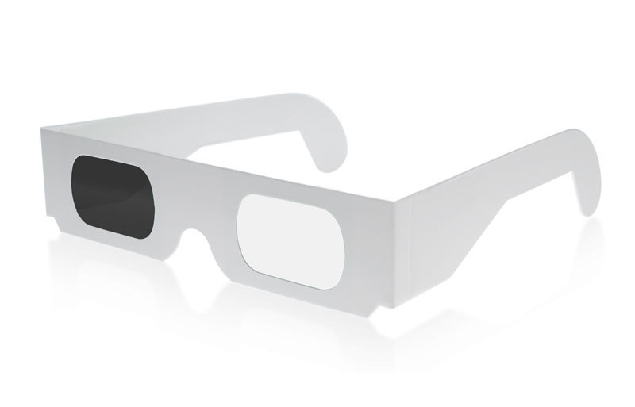
3D+2DTV
Time
L + α_{R} [R+(1-R)]
L L L L
L L L L
L L L L
3D+2D
L L L
R R R
R R R
Dimmer
L L L
R R R
R R R
As Seen Without Stereo Glasses
Notes:
Reducing the brightness of R and (1-R) by some factor α improves the contrast of the 2D view.
To the 3D viewer, this might seem strange: they see a brighter image with the left eye than the right. It’s as if they’re walking around wearing sunglasses with one lens darker than the other. Fortunately, the eyes quickly adjust separately to different brightness levels. Small differences are not noticeable, and even quite large differences are acceptable.

Slide 14
3D+2DTV
Time
L + α_{R} [R+(1-R)]
L L L L
L L L L
L L L L
3D+2D
L L L
R R R
R R R
Dimmer
L L L
R R R
R R R
As Seen Without Stereo Glasses
Variable-Length
L L L L L
R R
R R
Notes:
Rather than dimming the brightness of the R and (1-R) images, they could be shown at full brightness for different lengths of time. For example, the Left image could be shown for 3x as long as the others.

Slide 15
3D+2DTV
Time
L + α_{R} [R+(1-R)]
Brightness of Right Stereo Image
α_{R}=
Brightness of Left Stereo Image
Variable-Length
L L L L L
R R
R R
Notes:
This difference in time is the factor α that describes the difference in brightness between left and right images.

Slide 16
Darkest and Brightest Pixel of 2D Image
%
Variable-Length Frames:
Brightest Pixel = 1- α_{R}/(1+2α_{R})
Brightest Pixel:
Variable Length
L L L L L
R R
R R
Dimmed, Equal-Length Frames:
Brightness
Brightest Pixel:
Equal Length
Brightest Pixel = (1+α_{R})max_{L}
L L L
R R R
R R R
Darkest Pixel
%
%
%
%
%
α_{R}
Darkest Pixel = α_{R} max_{L}
Notes:
We can calculate the brightness of the brightest and darkest pixel. They depend directly on α.
The brightest pixel of the variable length display is brighter than the equal-length, dimmed display, and thus has higher contrast.

Slide 17


Viable α?
2D Normal
2D Low Contrast
Acceptable
2D View
α=0%
α=100%
Acceptable
3D View
3D Brightness
Too Unequal
3D Normal
Notes:
2D viewers see a normal image at low α; at high α the 2D image has low contrast.
3D viewers see a normal image at high α; at low α the 3D image is too unequal.
Is there a viable range of α that satisfies both?

Slide 18
Viable α?
OK
Acceptable
2D View
α=0%
α=100%
Acceptable
3D View
Notes:
2D viewers see a normal image at low α; at high α the 2D image has low contrast.
3D viewers see a normal image at high α; at low α the 3D image is too unequal.
Is there a viable range of α that satisfies both?

Slide 19
Theory
Experiments
2D Viewer Preferences
3D Depth Perception
3D Illusions
Prototype

Slide 20


Viewer Preference Test: Composite 2D Image
Standard 3DTV
3D+2DTV
Double-Image
Lower Contrast
α=40%
Notes:
On a 2D TV, we showed subjects a simulation of a 2D view of a standard 3D TV and our 3D+2DTV.
On the left is the 2D view of a 3DTV, with a pronounced double-image.
On the right, the 2D view of a 3D+2DTV, with no double-image, but with lower contrast.
We showed subjects both images, and asked which they prefer.

Slide 21


Viewer Preference Test: Composite 2D Image
Standard 3DTV
3D+2DTV
α=20%
α=40%
α=60%
Notes:
We showed subjects both images, and asked which they prefer. We repeated this for several levels of α, for several images.

Slide 22
2D Viewers Prefer 3D+2DTV to 3DTV
% Who Prefer
3D+2DTV
Variable-Length
Equal Length
%
%
%
%
%
α_{R}
Notes:
Subjects prefer the 3D+2DTV, especially at low α.

Slide 23
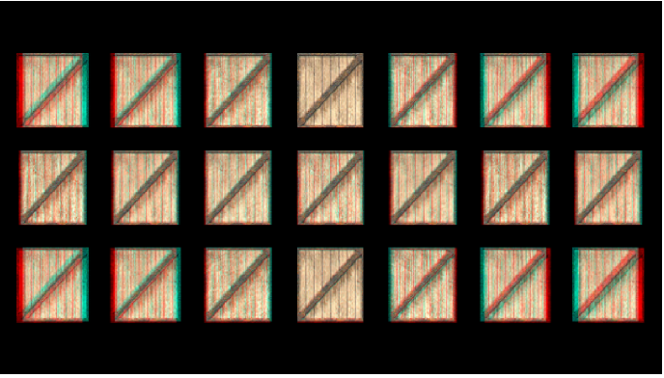
3D Depth Perception Test
Far
Near
Stereo Image Shown
Notes:
In a second experiment, on a 3DTV using stereo glasses, we showed subjects two rows of identically-sized boxes with differing horizontal disparities between left and right views, such that they appear at different depths, with the boxes on the left appearing further away than those on the right.

Slide 24
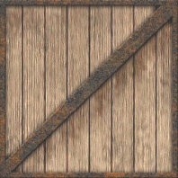


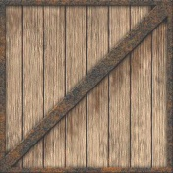



3D Depth Perception Test
Far
Near
Perceived 3D Image
Notes:
Looking through the stereo glasses, subjects saw a scene like this. The boxes appeared to be of the same size, but at different distances. These did not change throughout the experiment

Slide 25
3D Depth Perception Test
Perceived 3D Image
Notes:
In each trial of the experiment, we showed subjects a third row of boxes. All boxes in this middle row are some intermediate, identical depth.
We asked them which column of boxes are all at the same depth.
We repeated this experiment with the middle row of boxes at several depths, and with one eye dimmer to various values of α.

Slide 26
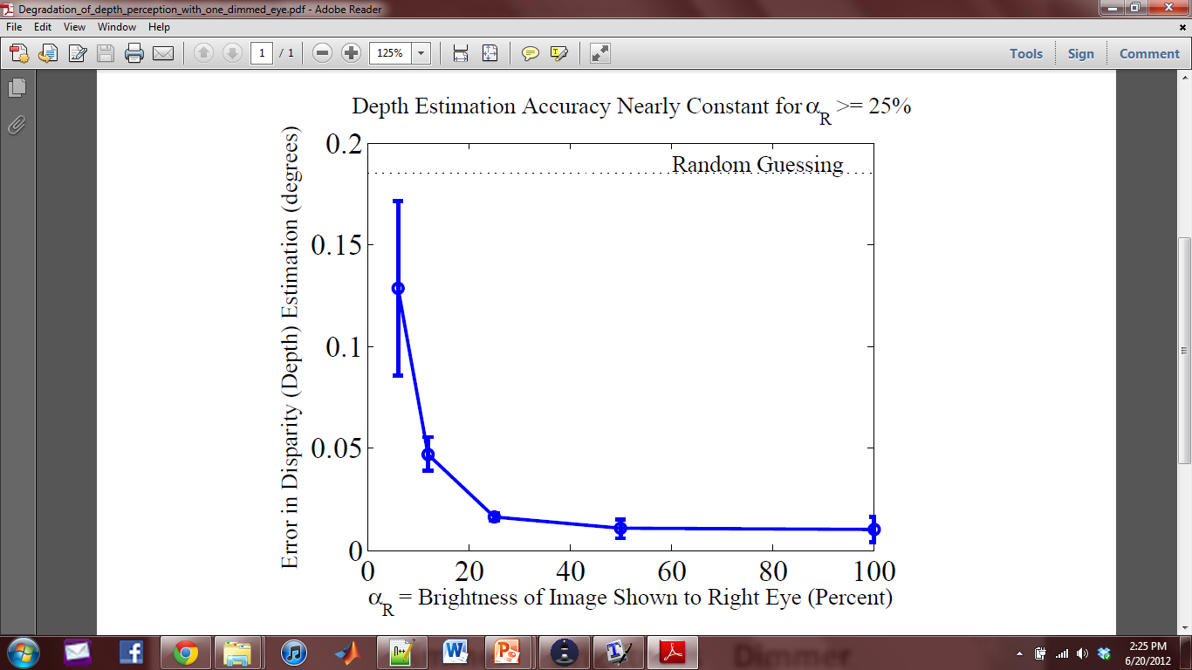
Depth Estimation Excellent for α ≥ 25%
Error in
Depth Estimation
(degrees disparity)
%
%
%
%
%
α_{R}
Notes:
Subjects made very few errors at α>25%

Slide 27
Viable α
α=40%
OK!
Acceptable
2D View
α=100%
α=0%
Acceptable
3D View
α=25%
Notes:
It seems that there is a viable level of α where 2D viewers prefer the 3D+2DTV and 3D viewers have good depth perception.

Slide 28
Adaptation to a Darker Image
Stationary Object
Dark Lens
Left Eye
Right Eye
Notes:
Looking at the world through sunglasses with one dark lens, the eyes quickly adjust to the difference.

Slide 29
Dimmer Image = Delayed Image
Stationary Object
SLOW
Notes:
The biological mechanism they use to adjust to the brightness difference causes an interesting issue.
The dark image reaches the brain a few milliseconds later than the bright image.
Stationary objects look the same now as a few milliseconds ago, so there is no noticeable difference.

Slide 30
Moving Objects: Disparity = Depth
Time = 1 … 2 … 3 … 4
Moving Object
Apparent Location
SLOW
Notes:
When one eye sees a moving object a few milliseconds after the other eye, the eyes see the object at different locations.
For a horizontally-moving object, this location difference causes and erroneous estimate of depth.

Slide 31

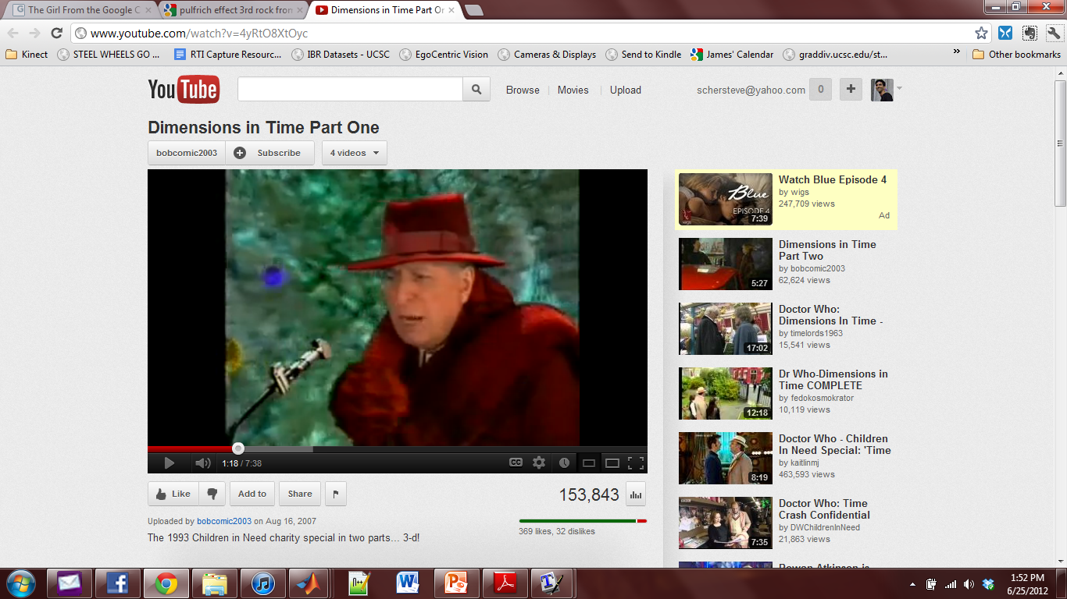
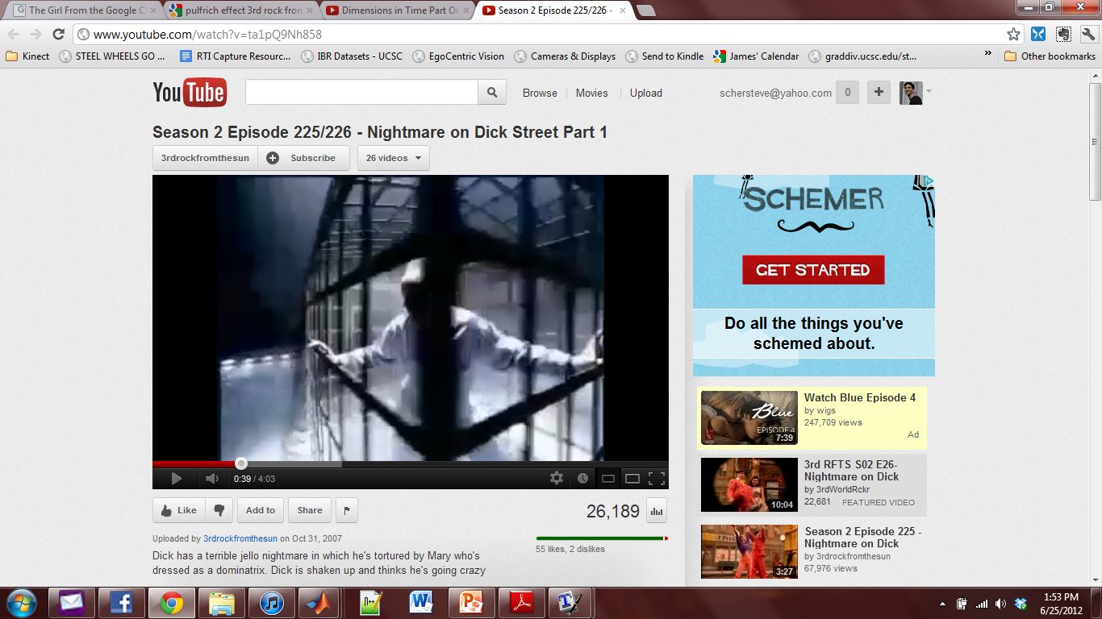
Pulfrich Effect Creates Depth
Super Bowl Commercial - Diet Coke
Doctor Who
3rd Rock from the Sun
Notes:
This effect has been used in commercial TV to create the appearance of depth on a standard 2D TV.
Paper glasses with one dark lens were distributed to the audience. Videos featuring many objects moving quickly and horizontally across the screen, so they appear at different depths.

Slide 32
3D Depth Perception of Moving Objects
Stereo Image Shown
Notes:
In a third experiment, on a 3DTV using stereo glasses, we showed subjects the same scene as before:
two rows of identically-sized boxes with differing horizontal disparities between left and right views, such that they appear at different depths, with the boxes on the left appearing further away than those on the right.

Slide 33
3D Depth Perception of Moving Objects
Perceived 3D Image
Notes:
As before, looking through the stereo glasses, subjects saw a scene like this. The boxes appeared to be of the same size, but at different distances. The rows of stationary boxes did not change throughout the experiment
A new box was shown moving horizontally. Subjects were asked which stationary box is at the same depth as the moving box. They answered, for example, that the stationary boxes in the 3rd column are at the same depth as the moving box. We then dimmed the view through one eye. At lower levels of Alpha, they reported the moving box to be at a consistently erroneous depth, for example at the 6th column. We repeated the experiment with the object moving in different directions and speeds, at different depths, with various levels of Alpha.

Slide 34
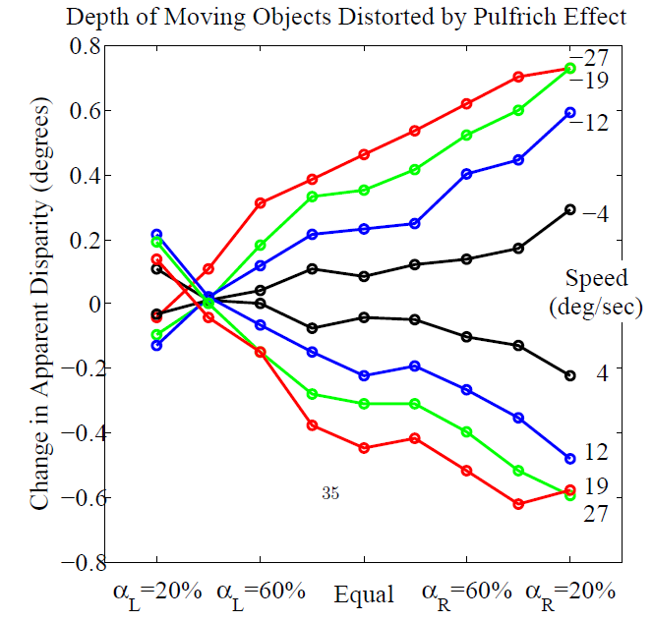
Depths of Moving Objects Distorted
→ Fast
→ Slow
Depth Error (Degrees)
← Slow
← Fast
Left Eye Dimmer
Equal Brightness
Right Eye Dimmer
Notes:
Depth errors were smaller for slow objects, and larger for fast-moving objects.
Objects moving in opposite directions (left and right) led to depth errors in opposite direction (further and closer)
Dimming the opposite eye creates a depth perception error in the opposite direction (further vs. close).
This is all consistent with the time-delay theory.
When the two eyes are shown images of equal brightness, depth errors are not zero. This is because the 3DTV is a sequential-frame stereo display. At 120Hz, it has an 8ms delay between showing images to the left and right eyes. This delay (and attendent depth error) is present in all sequential-frame stereo displays.
This depth distortion is cancelled out by the Pulfrich-effect induced distortion at an alpha of about 40%.
* A 3D+2DTV reduces depth distortion errors rather than increasing them, the Pulfrich effect will not cause problems to the 3D+2DTV.
* The magnitude of these effects is small enough that they are ignored in current 3DTV’s, so they can probably also be ignored in a 3D+2DTV.

Slide 35
Theory
Experiments
Prototype

Slide 36
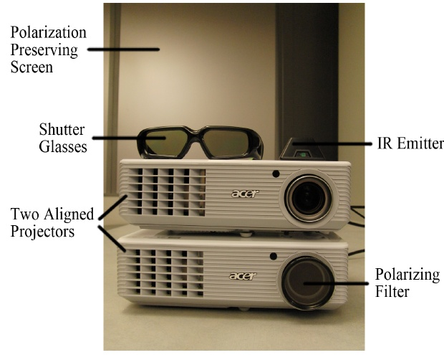
Prototype
Notes:
We built a prototype using two aligned projectors.

Slide 37
Prototype
L
3D Glasses
R
L
R
3D Projector

Slide 38
Prototype
L
3D Glasses
(With Polarizing Filter)
R
R
L
R
R
Polarizing Filter
Notes:
The 3D projector shows separate Left and Right images through stereo glasses.
The second, 2D projector shows the inverse of the Right image through a polarizing filter. Active-shutter LCD stereo glasses contain a linear polarizing element that blocks this image.

Slide 39
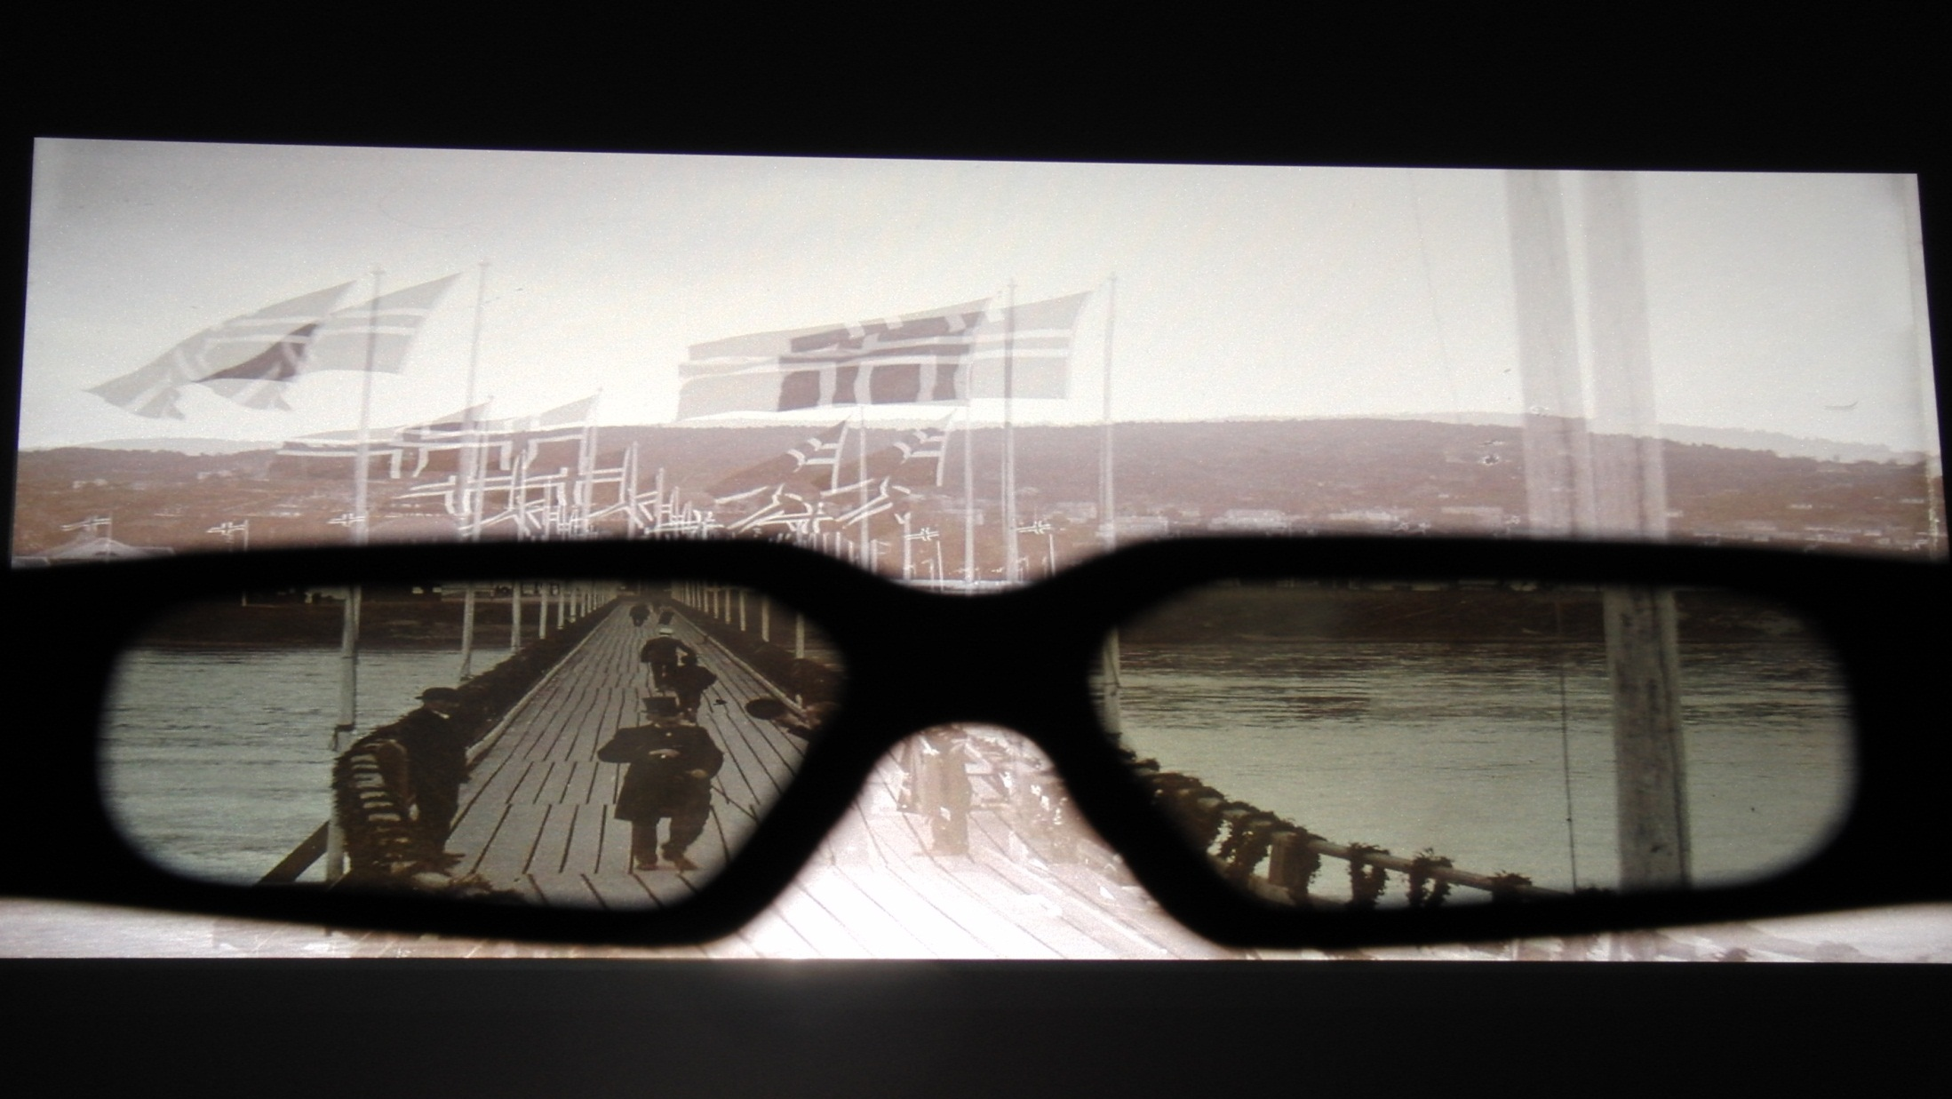
Standard 3D TV
Notes:
This is a standard 3DTV.
At the bottom of the screen, separate Left and Right images are visible through stereo glasses.
Above the glasses, the 2D view is seen. Notice the double-image of the flags.

Slide 40
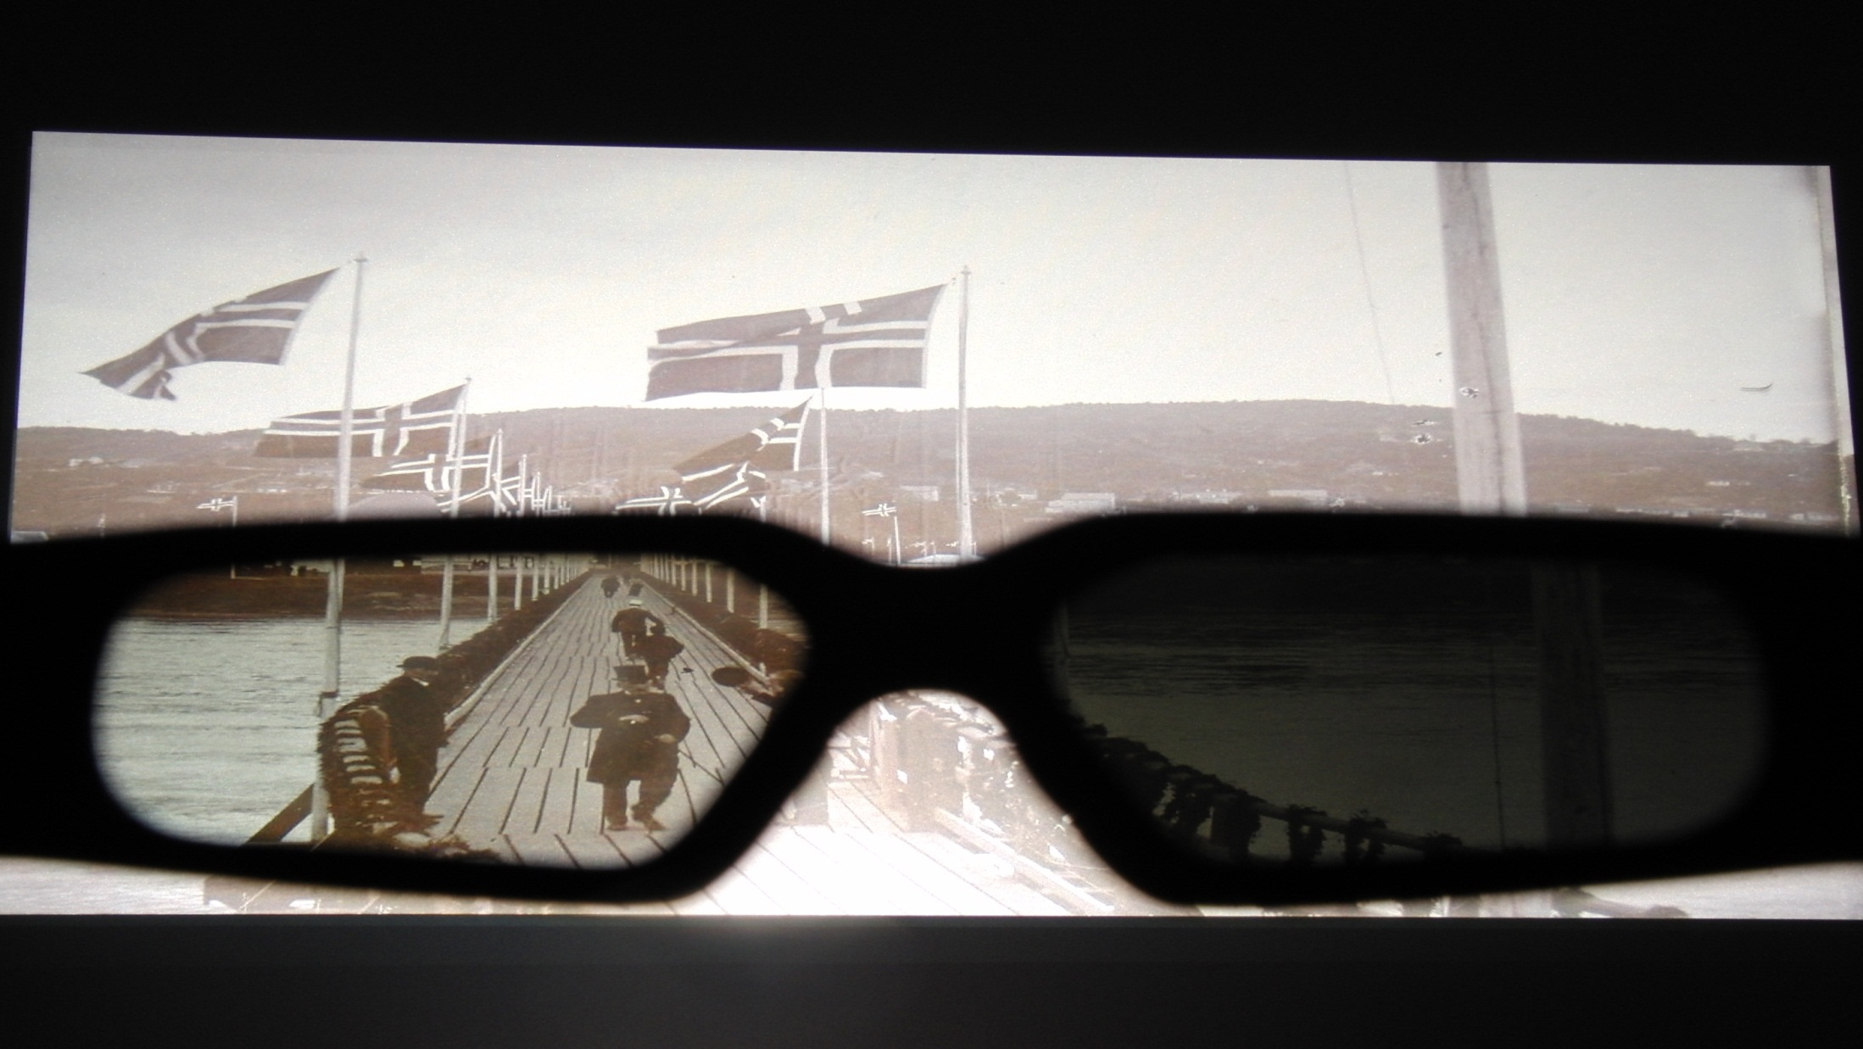
3D + 2D TV Prototype
Notes:
This is our 3D+2DTV prototype.
Above the glasses, the 2D view is seen. Notice there is no double-image of the flags.
At the bottom of the screen, separate Left and Right images are still visible through stereo glasses. The right image is darker than the left. The image does not appear nearly this dark when viewed through stereo glasses, as the eyes adjust to the new light level.

Slide 41
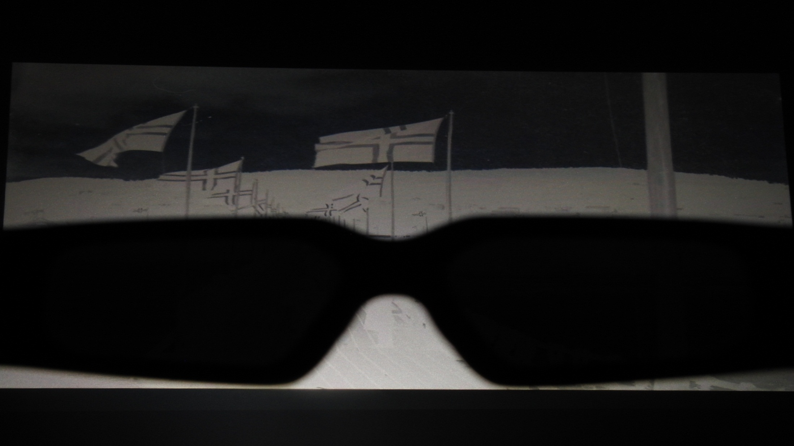
Third Channel: Inverse of Right Eye
Notes:
This is the inverted right image

Slide 42
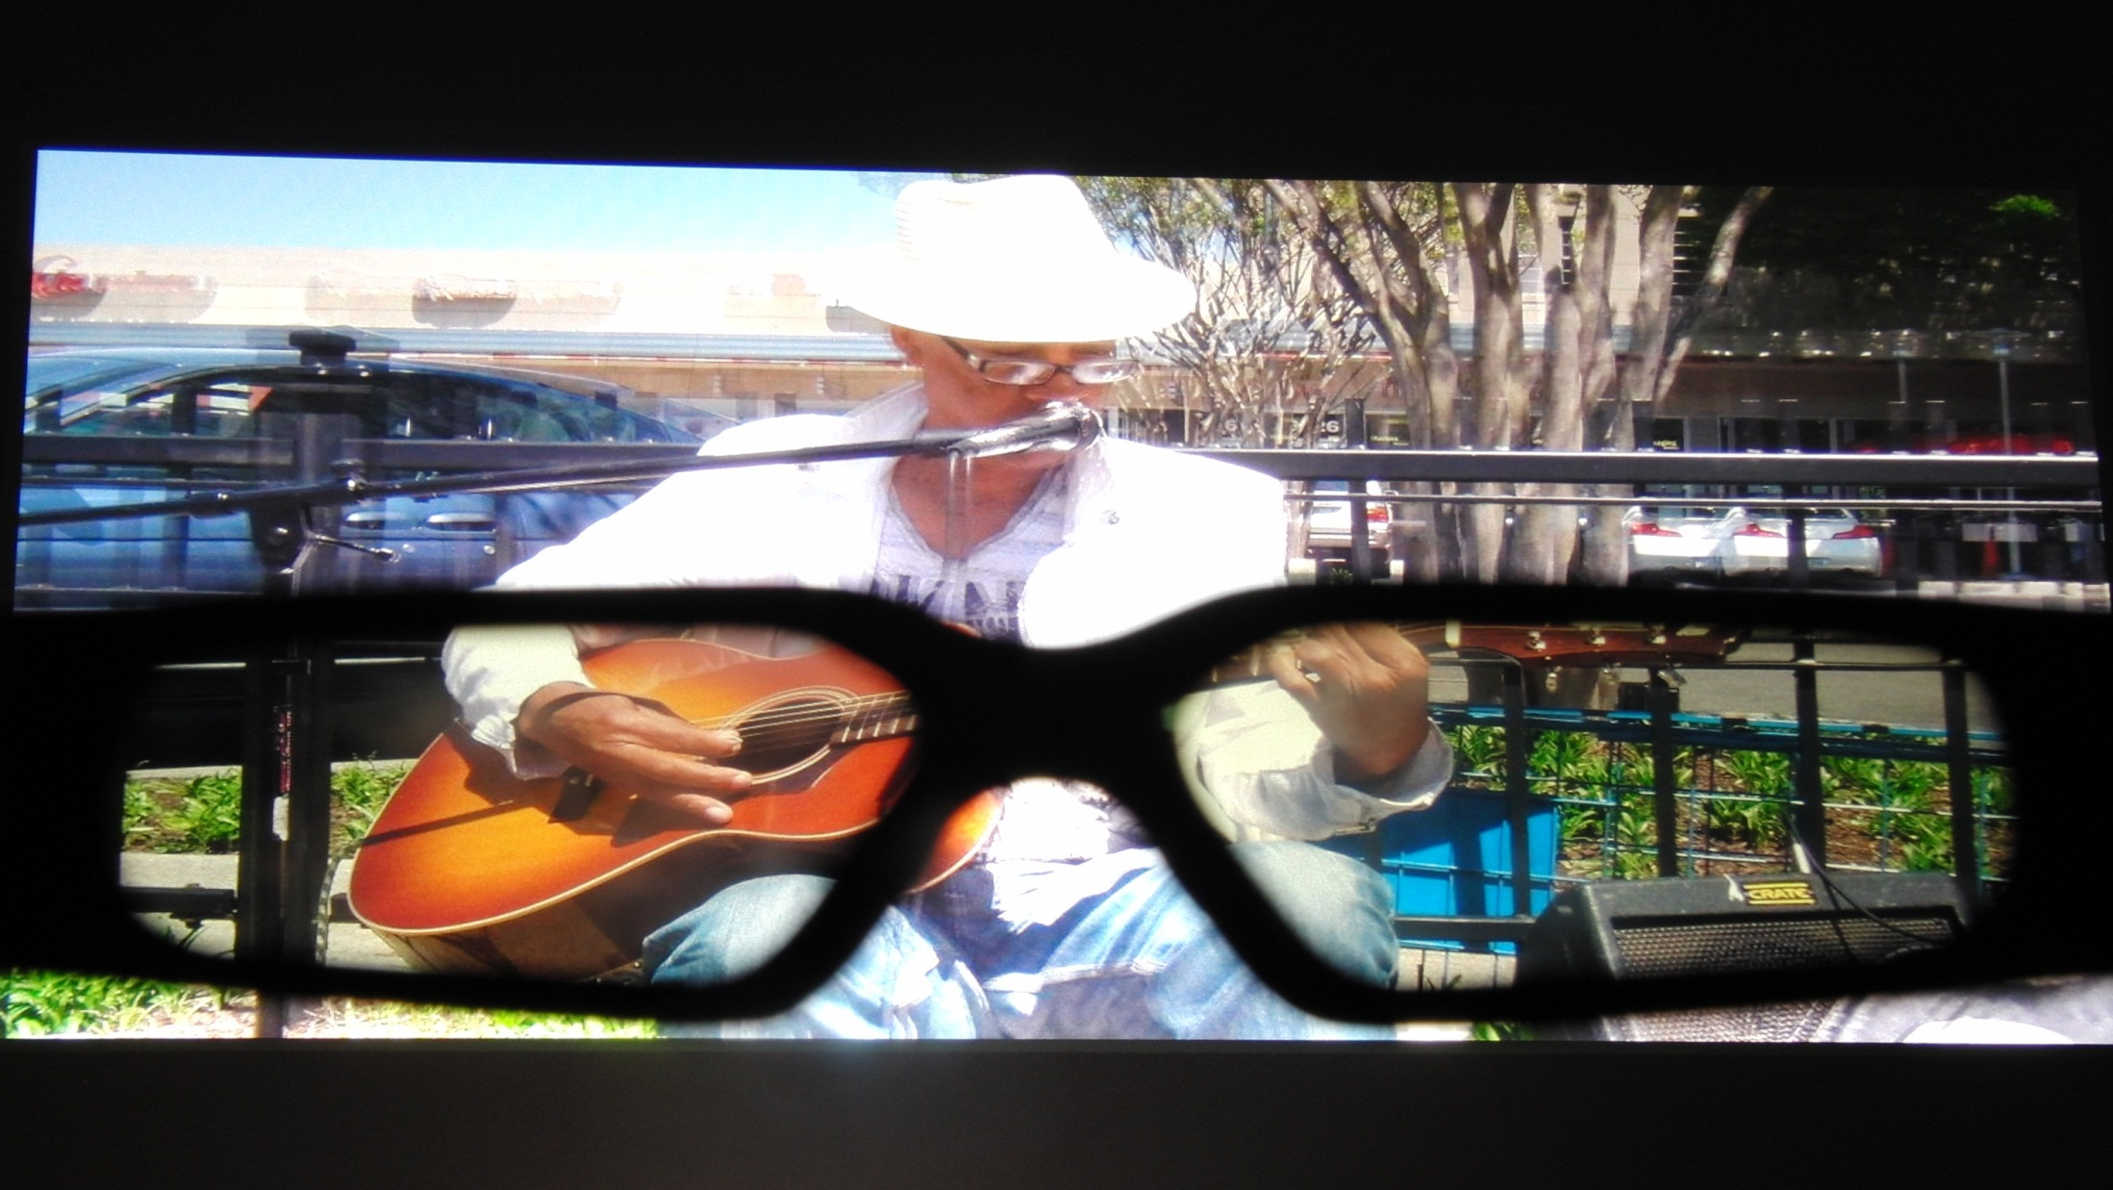
Standard 3D TV
Notes:
This is a standard 3DTV. Notice the double image around the trees on the right.

Slide 43
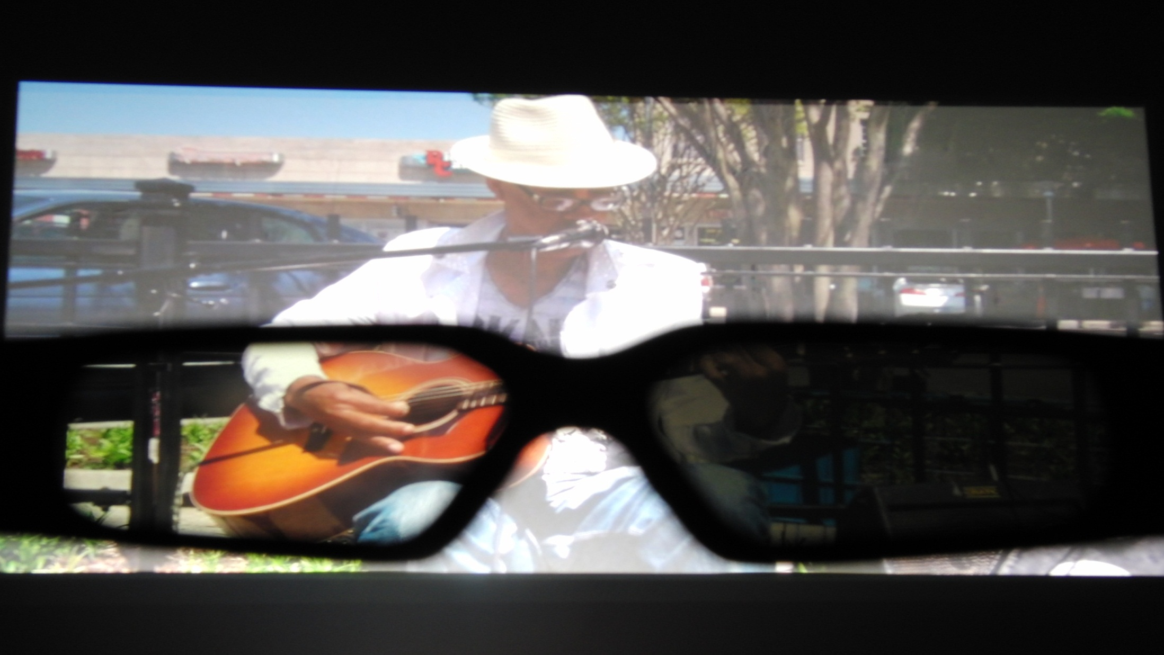
3D + 2D TV Prototype
Notes:
This is the 3D+2DTV prototype. Notice that the double-image of the trees on the top-right is removed.

Slide 44
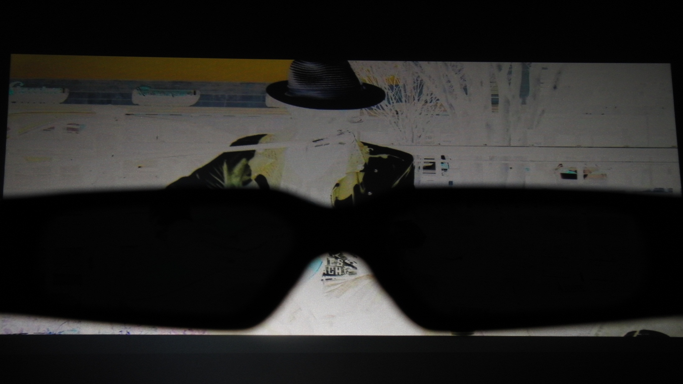
Third Channel: Inverse of Right Eye

Slide 45
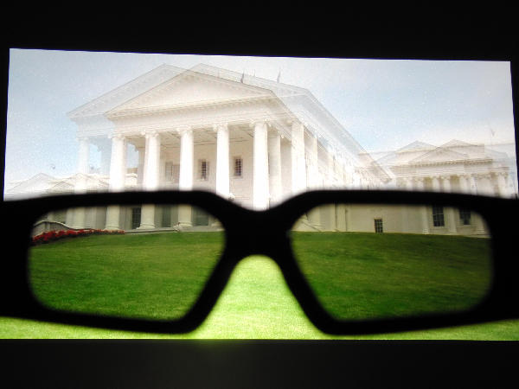
Standard 3D TV
Notes:
This is a standard 3DTV. Notice the double-image in the columns of the building.

Slide 46
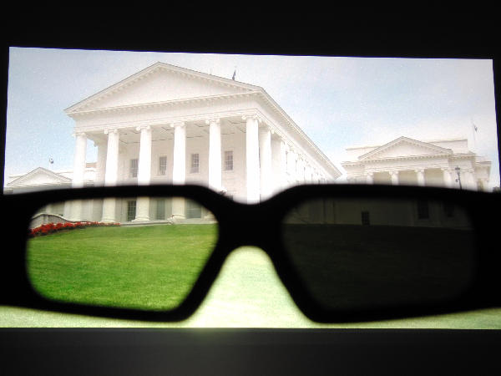
3D + 2D TV Prototype
Notes:
This is a 3D+2DTV prototype. Notice that there is no double-image in the columns of the building.

Slide 47
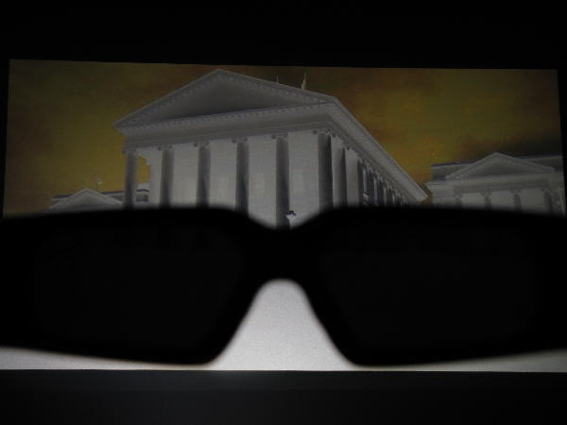
Third Channel: Inverse of Right Eye

Slide 48
Thank you
Please stay after the next talk to see a
live demo of a
new single-projector prototype
http://graphics.soe.ucsc.edu/papers/3d2dtv/
Notes:
At Siggraph, we showed a live demo of a new prototype using a single 180Hz projector and altered stereo glasses that block both eyes of the 3D viewer while the inverse frame is shown.

Slide 49
Two-Frame 3D+2DTV
Time
L + R+(1-R)
L L L L
L L L L
L L L L
Three Frames
L L L
R R R
R R R
Two Frames
L L L
As Seen Without Stereo Glasses
R R R
R R R
Notes:
A Two-frame scheme is also possible.
The stereo glasses have a transparent left lens. This eye sees the same image as a 2D viewer.
This has a benefits over three-frames, with a higher frame rate.
However it also introduces a further difference between the images seen by the 3D viewers two eyes. Also, the contrast is similar to the Equal-Frame, Dimmed version of the 3-Frame 3D+2DTV, rather than the variable-length frame version.

